Slide 1
Optimizing Active Vision-Based Policy for Robotic Grasping through 3D Point Cloud Feature Extraction
A Comparative Study
Uthiralakshmi Sivaraman
Advisor: Prof. Berk Calli

Slide 2
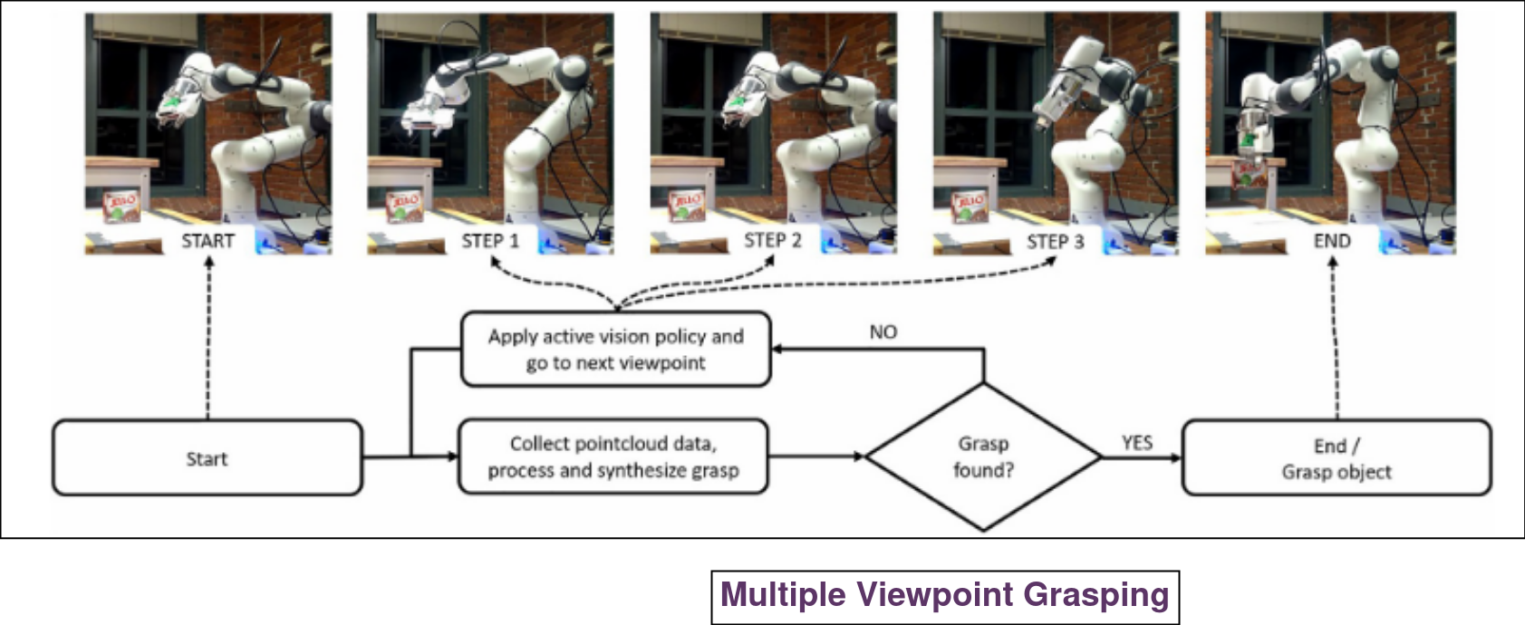
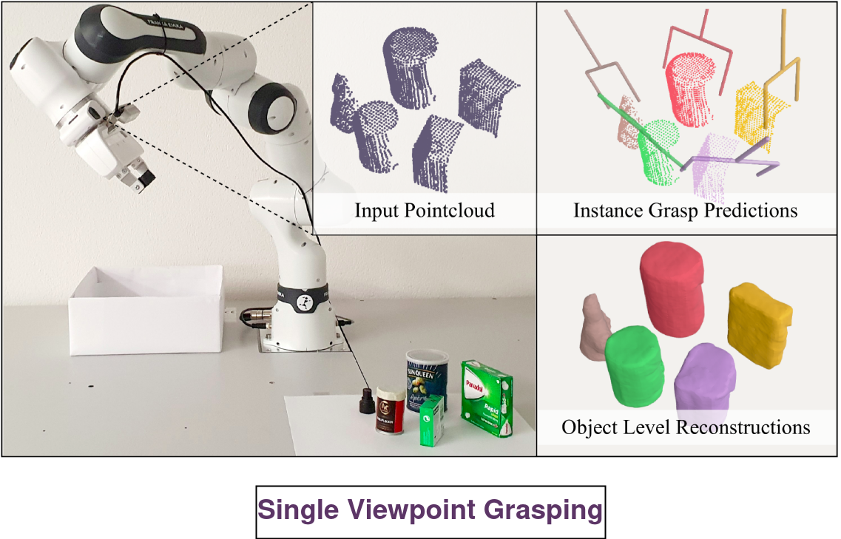
Vision based Robotic Grasping
Capture Camera data to find sufficiently good grasp using robotic arms.
Grasping using Single image vs multiple images vs Real time.

Slide 3
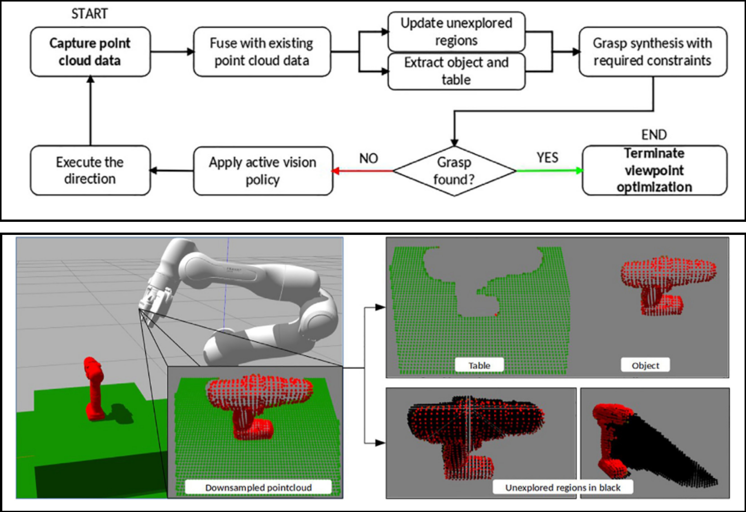
Active Vision Policy for Grasping
Franka Emika Panda arm with Intel Real Sense Kinect mounted.
Collect object data through camera movement.
Capture and process point cloud data.
Apply Active Vision Policy to predict next camera movement.

Slide 4
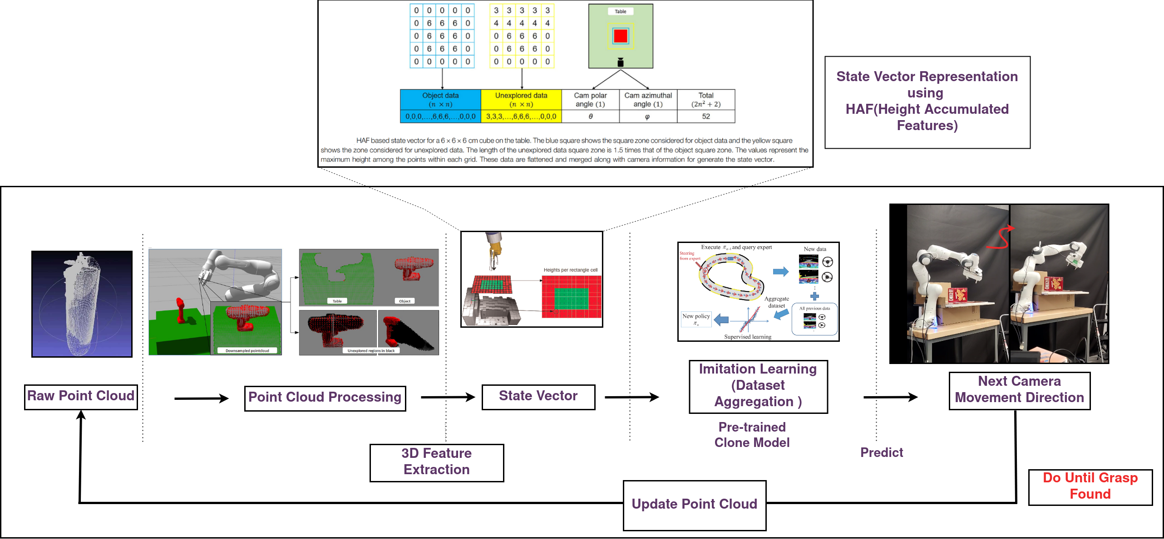
Imitation Learning based Policy Prediction
Imitation learning- Dataset Aggregation (Dagger) to predict the next camera viewpoint direction.
Epsilon Optimal Expert demonstration for imitation.
0° to 360 ° camera movement space with ±5° increment.

Slide 5
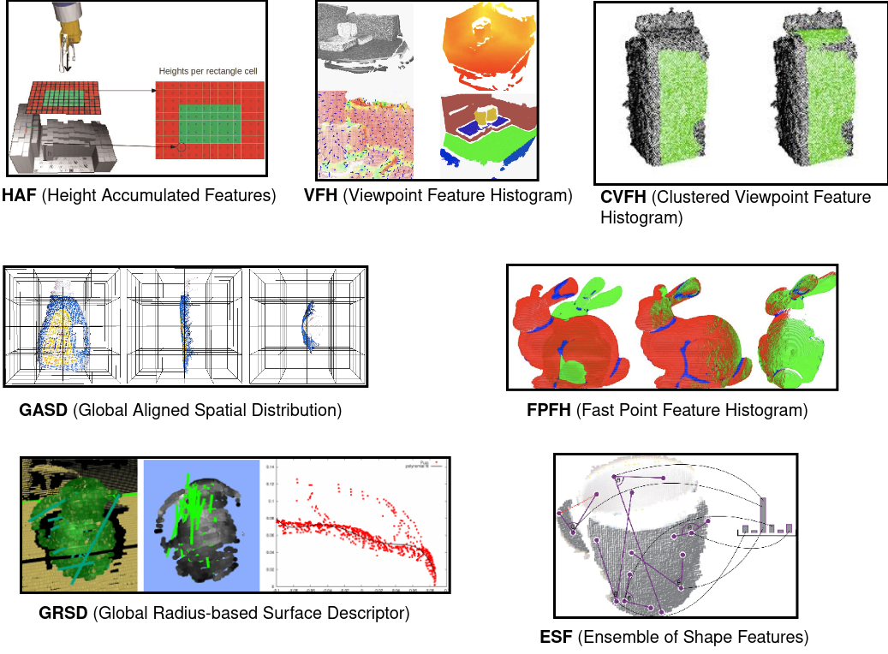
Comparison of 3D Feature Descriptors
Process raw RGB point cloud using feature descriptors to enhance object recognition
7 different features
HAF, VFH, CVFH, GASD,FPFH,GRSD, ESF

Slide 6
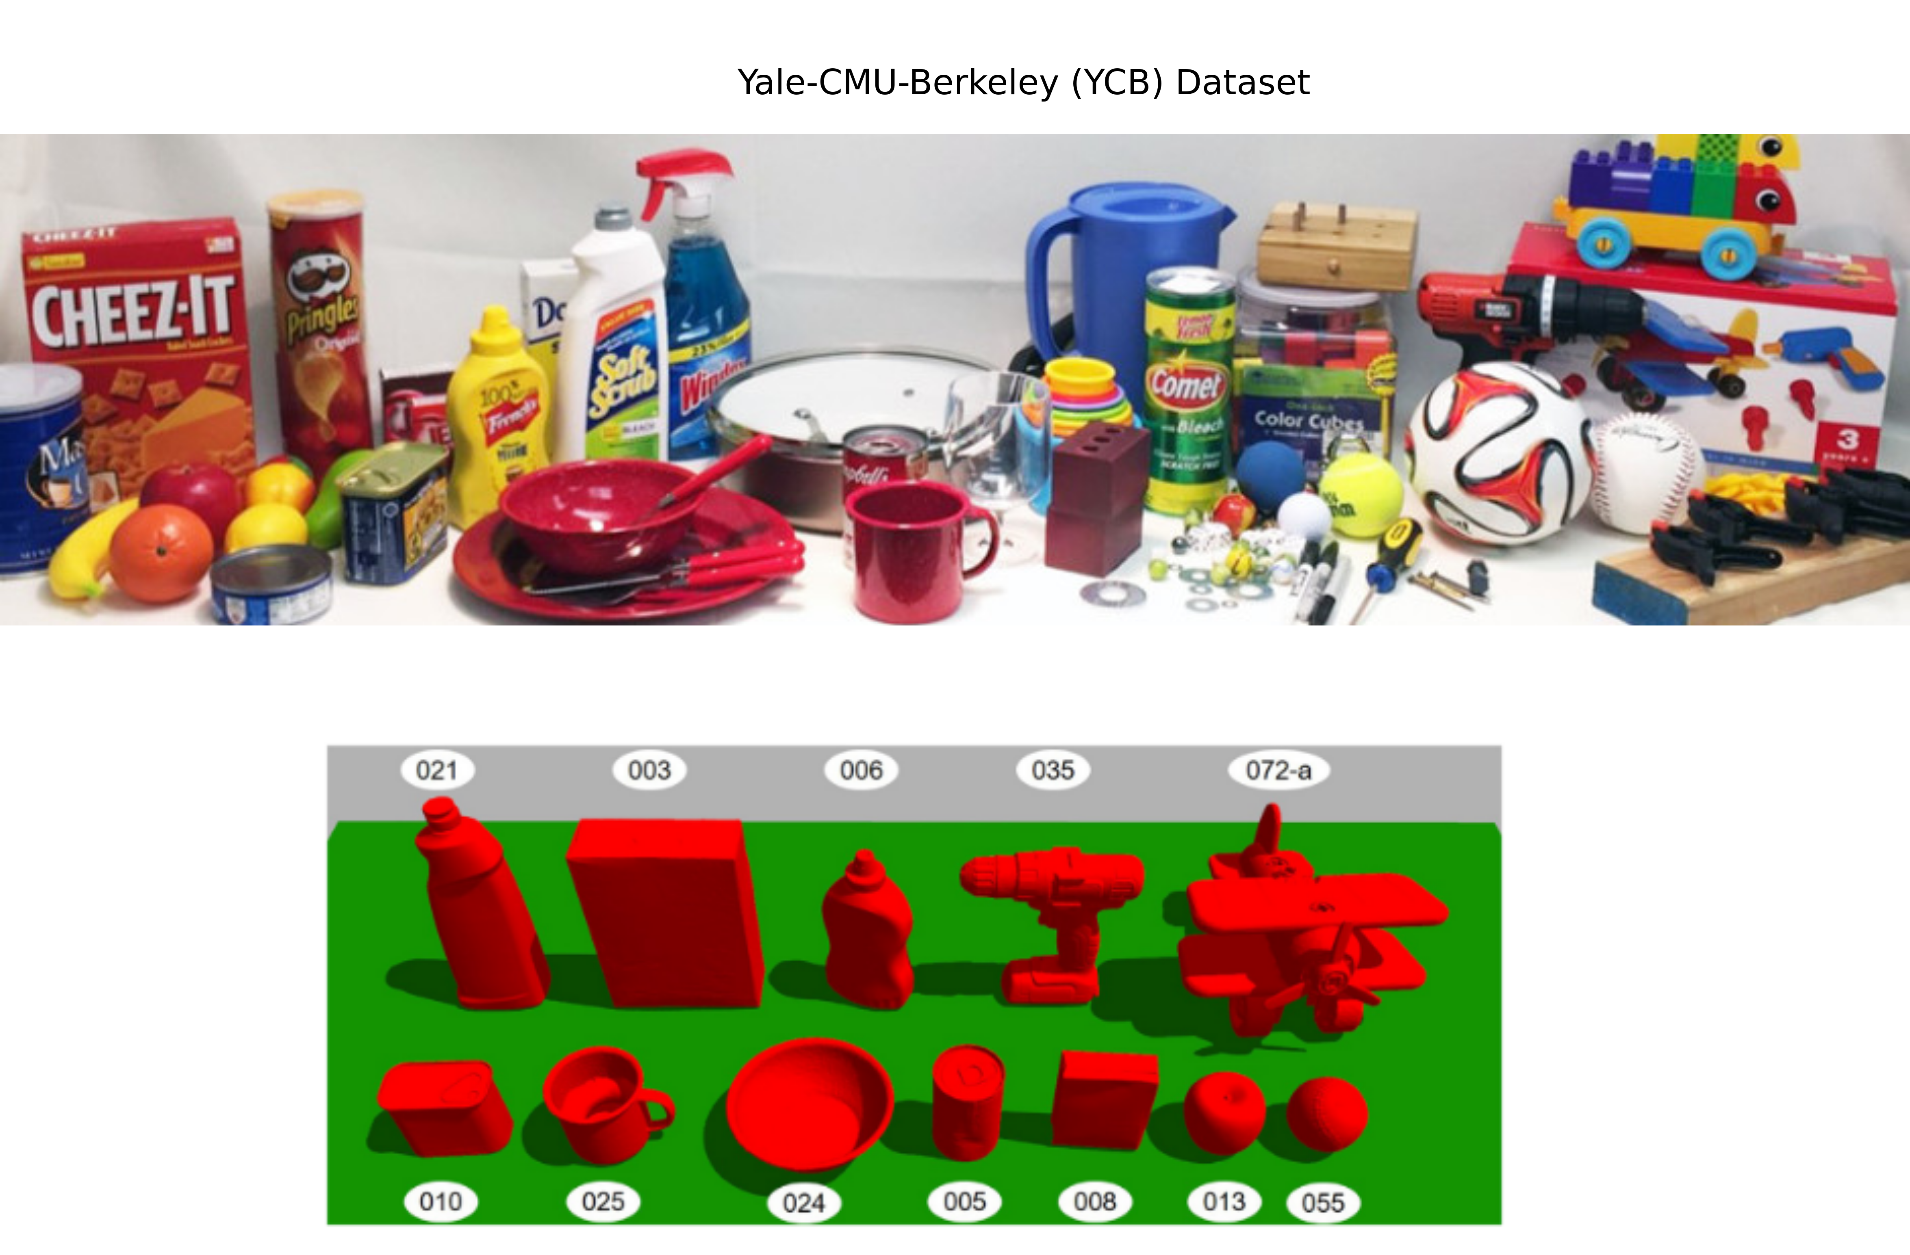
Dataset
A subset of Yale-CMU-Berkeley (YCB) Object and Model Set
Objects of daily life with different shapes, sizes, textures, weight and rigidity
Widely used for robotic manipulation benchmark

Slide 7
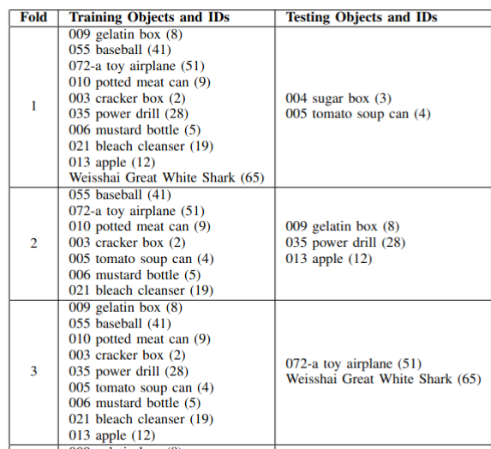
Methodology and Evalution Metrics
Number of camera movement steps taken to find Successful Grasp
Mean cumulative reward and standard deviation
Model training time vs evaluation time
Percentage of Successful Grasps
3 cross-validation folds and test on simulation

Slide 8
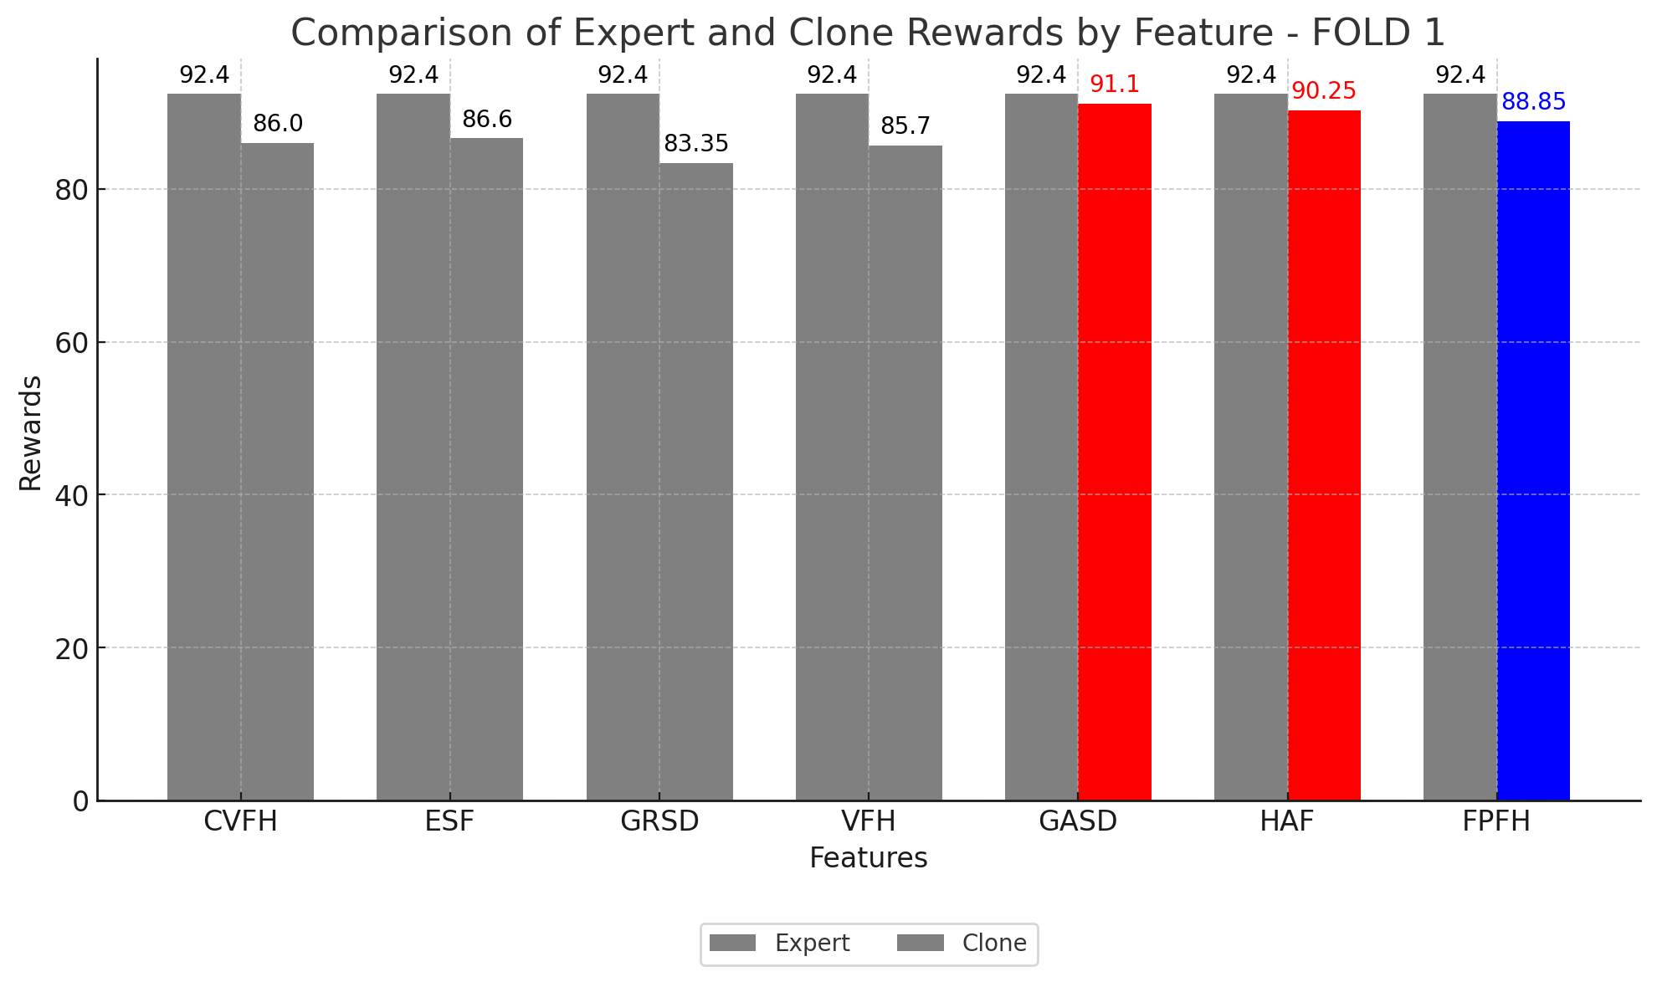
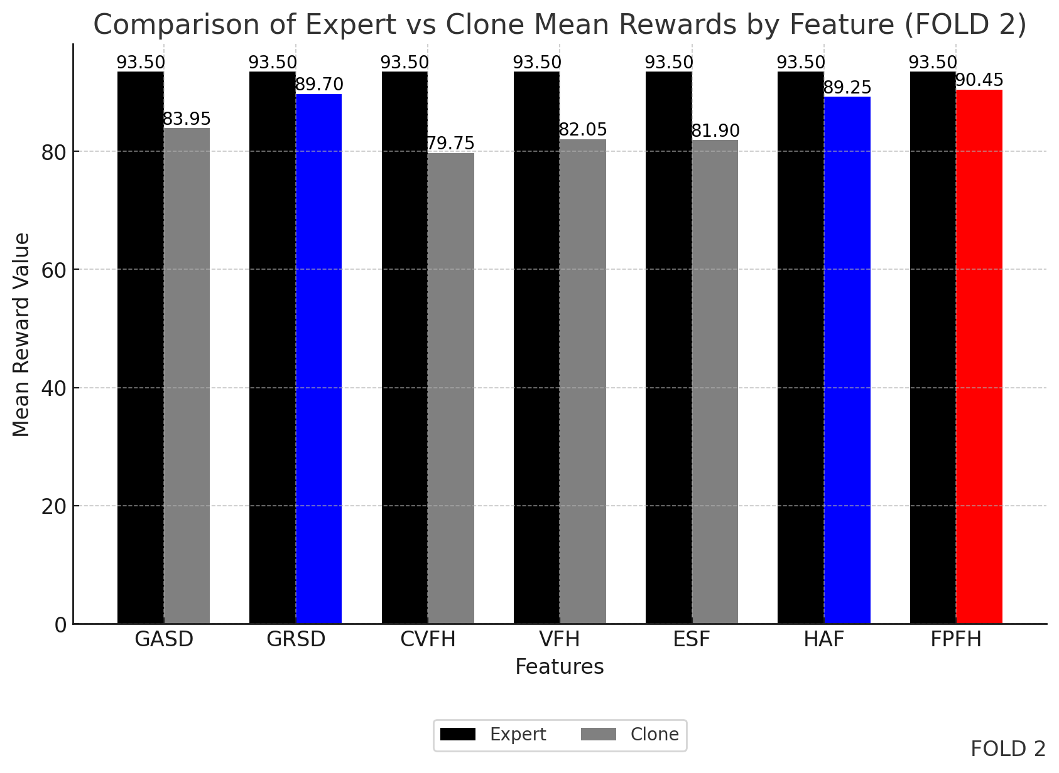
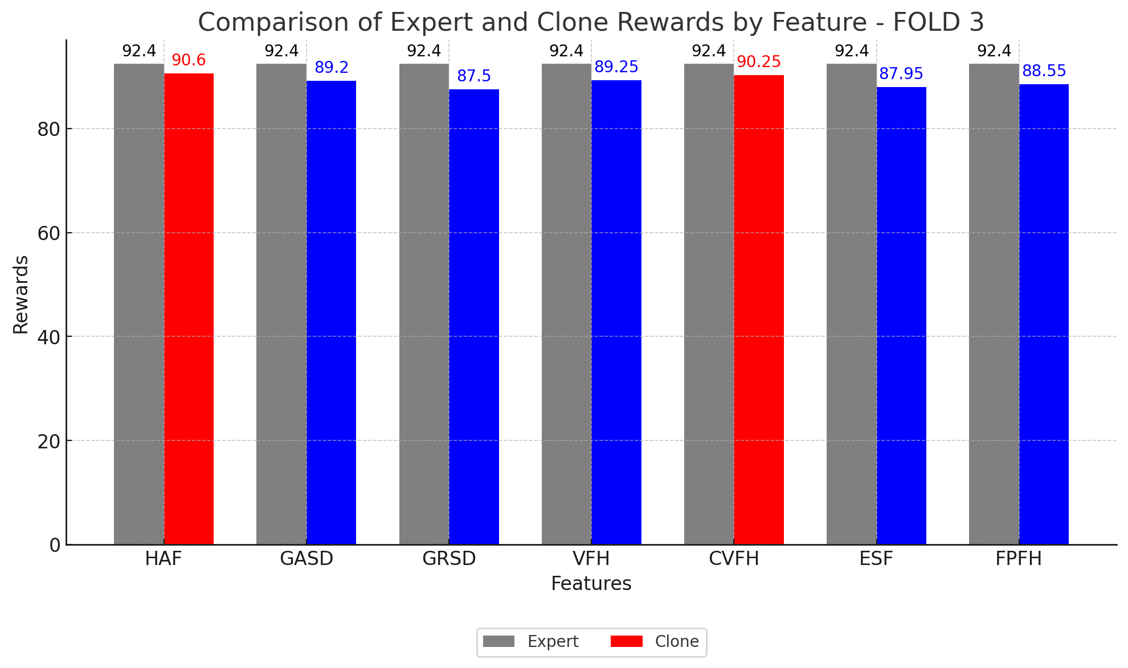
Train Results

Slide 9
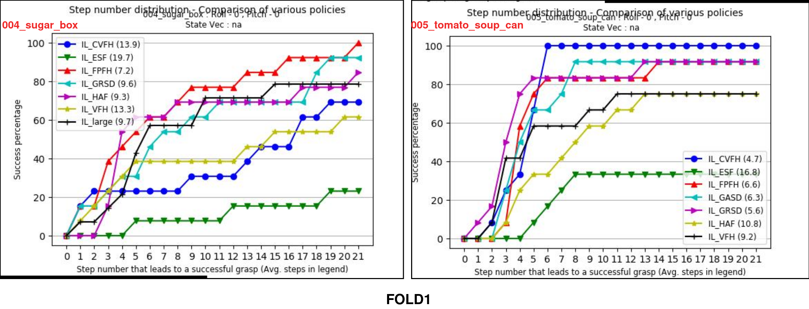
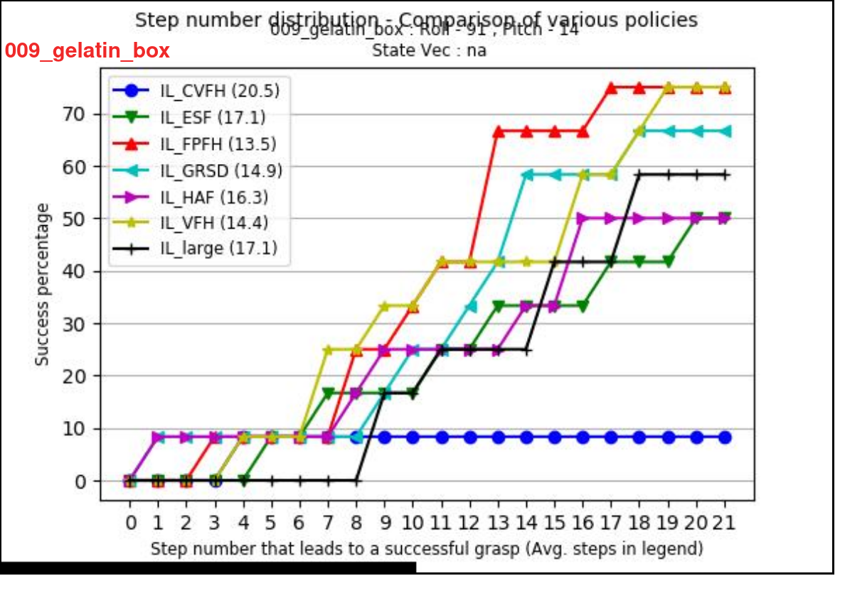
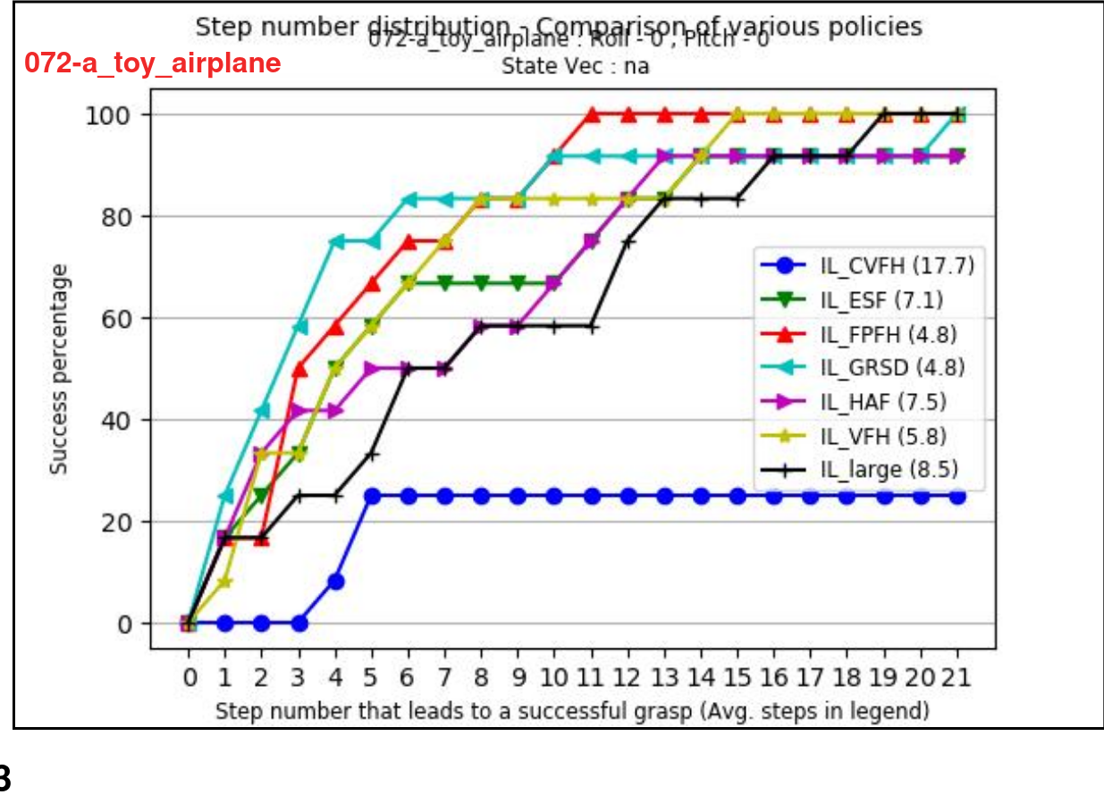
Test Results
FOLD2
FPFH showing
optimal performance
and efficiency in training time.
FPFH excelled in learning
curves and efficiency
across all folds.
FOLD3

Slide 10
Thank You!
Any Questions?

Slide 11
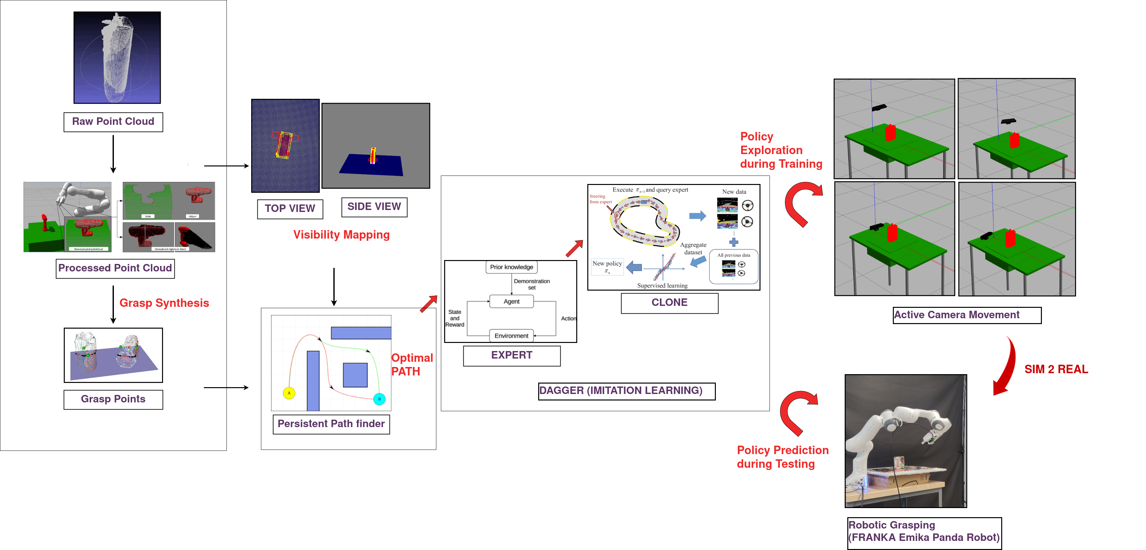
Imitation Learning with Expert Demonstration

Slide 12
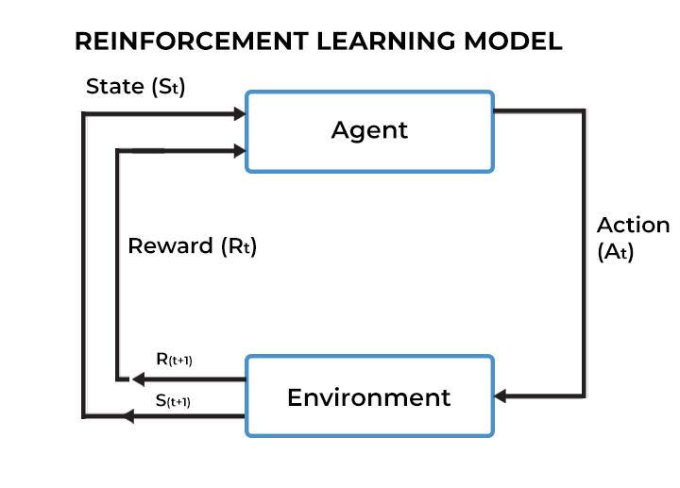
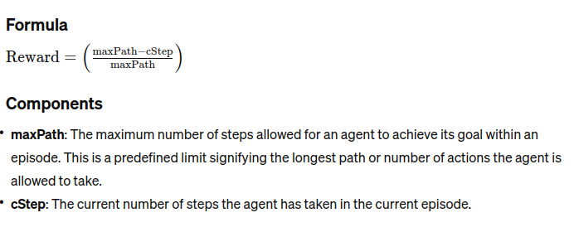
Imitation Learning Reward Calculation
maxPath- The maximum number of steps allowed for an agent to achieve its goal within an episode.
cStep- The current number of steps the agent has taken in the current episode.
During training, the imitation learning policy explores all possible camera movements.​
Clone imitates expert to achieve maximum cumulative reward

Slide 13
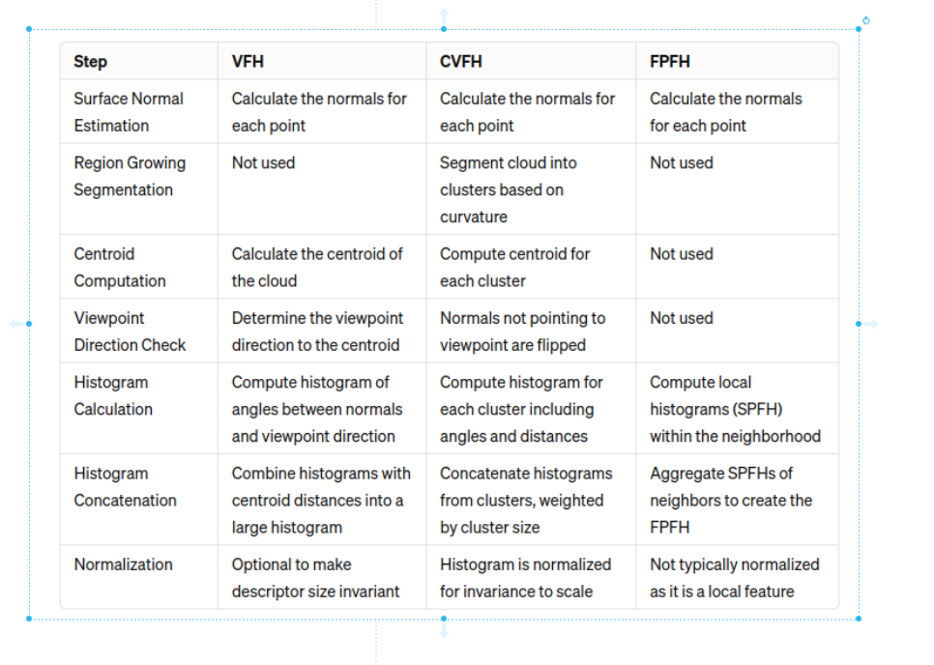
VFH, CVFH, FPFH

Slide 14
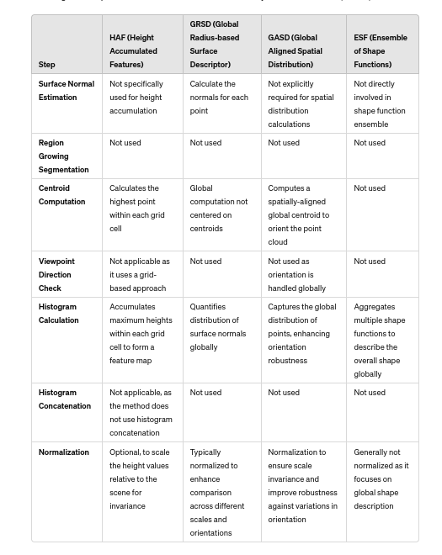
HAF, GASD, GRSD, ESF

Slide 15
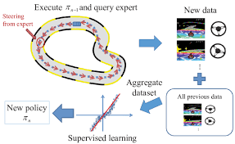
Dagger (Dataset Aggregation)

